Slide 1

Exploratory Data Analysis
G2M Insight For Cab Investment Firm
18.06.2022

Slide 2

Agenda
Problem Statement
Regarding the Datasets
EDA
Hypothesis
Conclusion

Slide 3
Problem Statement
XYZ is a private firm in US. Due to remarkable growth in the Cab Industry in last few years and multiple key players in the market, it is planning for an investment in Cab industry and as per their Go-to-Market(G2M) strategy they want to understand the market before taking final decision.
Provide actionable information to assist XYZ firm in determining the best company for investment.
Cab Companies
Yellow Cab
Pink Cab

Slide 4
Regarding the Datasets
There are 4 datasets:
Cab_Data.csv - This file contains transaction information for two taxi businesses.
City.csv - This file offers a list of cities in the United States, their populations, and the number of taxi users.
Customer_ID.csv - This is a mapping table with a unique identifier that connects the customer's demographic information.
Transaction_ID.csv - This is a mapping table with transaction to customer mapping and payment method information.
Timeframe of the data: 2016/01/02 to 2018/12/31.
Total data points : 356,392
24 Features( including 9 derived features)
Cab_Data.csv
Customer_ID.csv
Transaction_ID.csv
City.csv
USholiday.csv
Final cab data

Slide 5
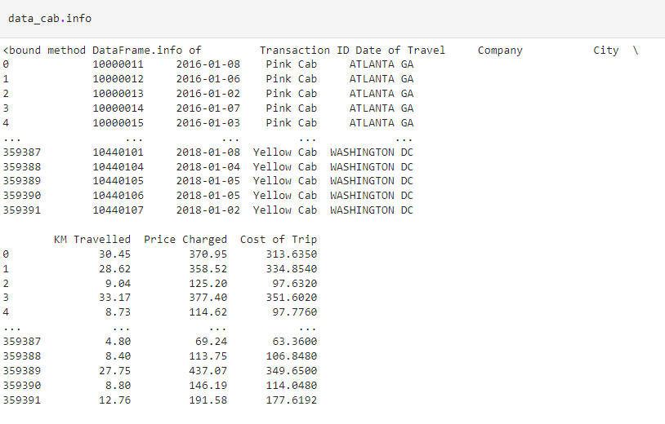
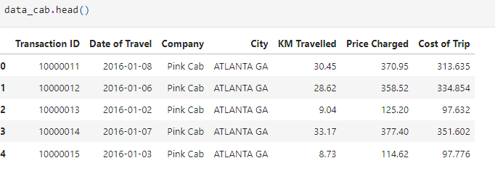
Profit Analysis
Cab Data.csv Dataset

Slide 6
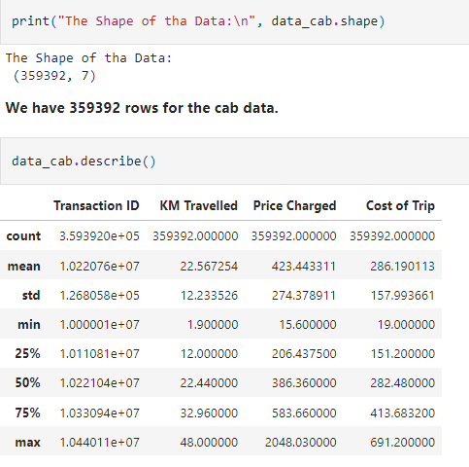
Profit Analysis
As you see, there are 359392 data points.
There is no NA value.
No duplicated row.

Slide 7
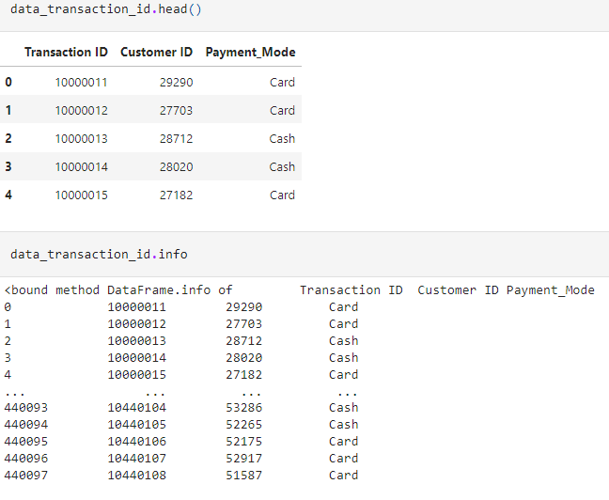

Profit Analysis
Transaction ID Dataset
As you see, there are 440098 data points.
There is no NA value.
No duplicated row.

Slide 8
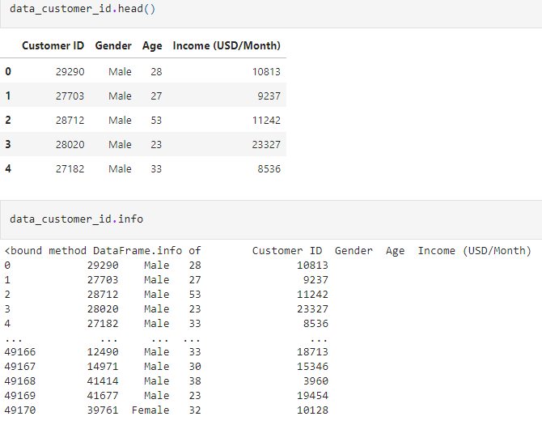
Profit Analysis
Customer ID Dataset

Slide 9
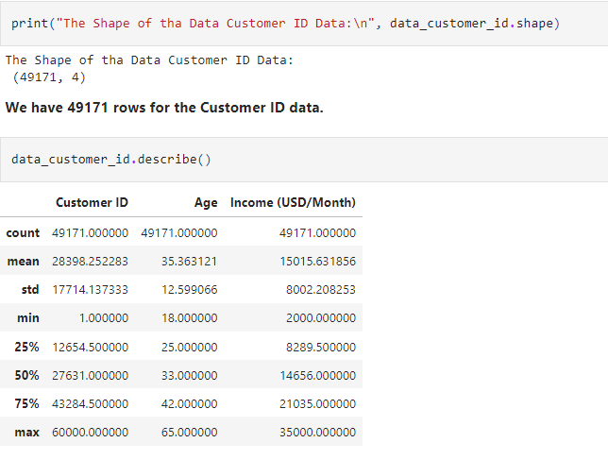
As you see, there are 49717 data points.
There is no NA value.
No duplicated row.

Slide 10
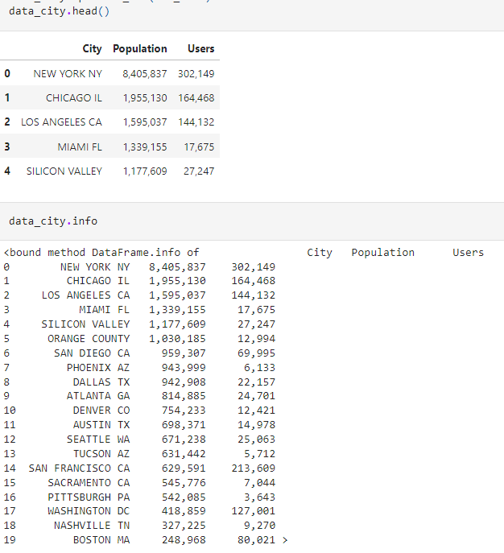
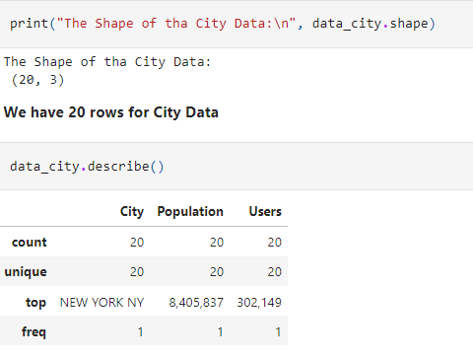
Profit Analysis
City Dataset
As you see, there are 20 data points.
There is no NA value.
No duplicated row.

Slide 11
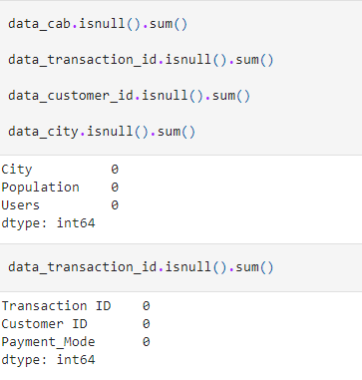
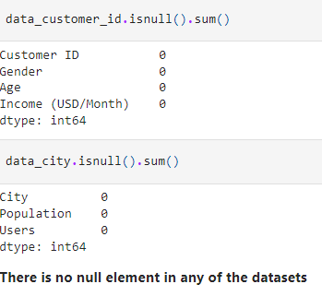

Slide 12
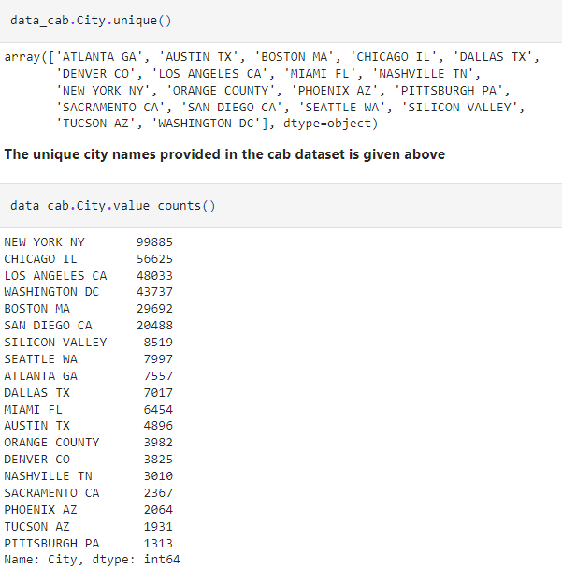
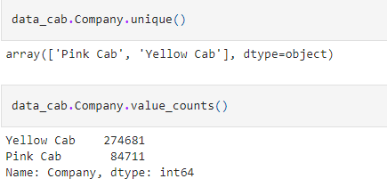
Cab Data Analysis

Slide 13
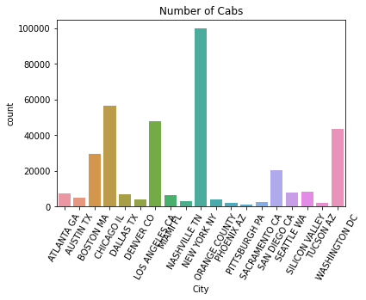
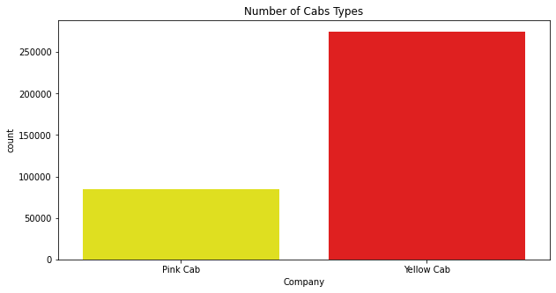
Cab Data Analysis
According to the given graphs, the highest number of cabs are in NYC and
the yellow cab is much more preferred than the pink cab.

Slide 14
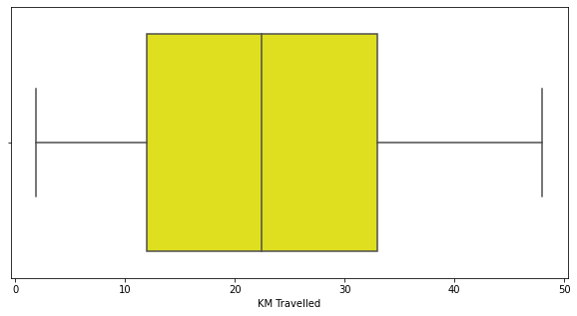
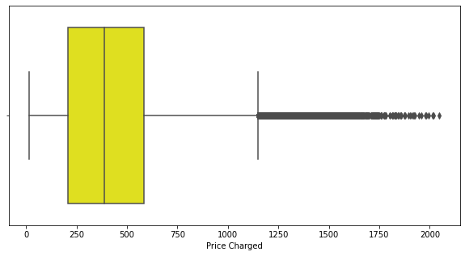
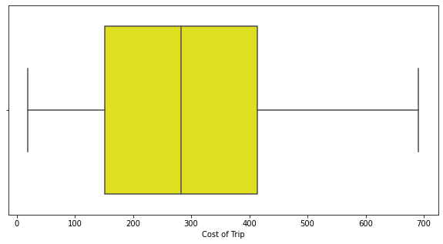
Cab Data Analysis
We can see the average, max and min values of ‘km travelled’,
‘price charged’ and ‘cost of trip’ parameters.

Slide 15
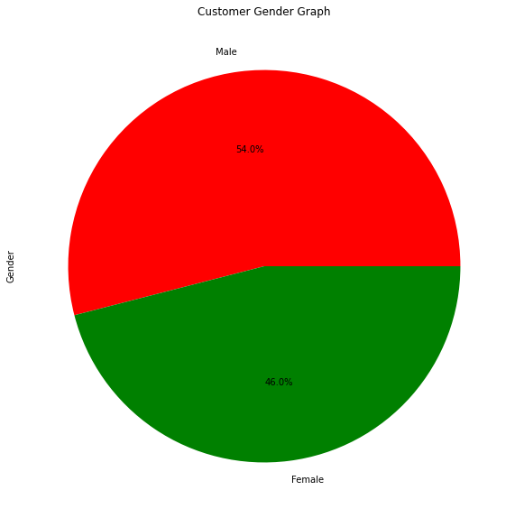
Customer ID Dataset Analysis
The number of male customers are slightly
higher than the female customers

Slide 16
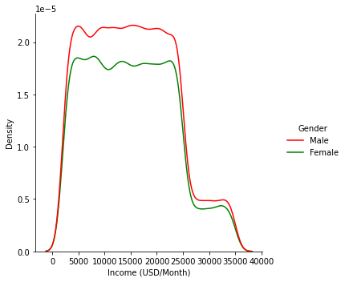
Customer ID Dataset Analysis
We can also check the income density
graph of genders.

Slide 17
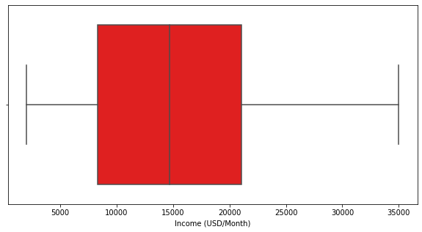
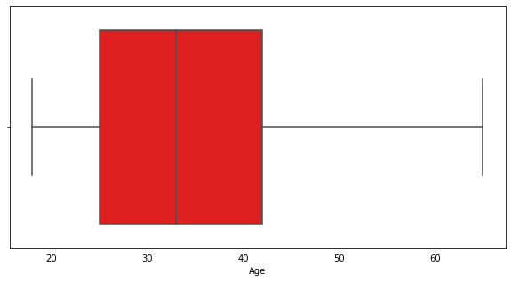
Customer ID Dataset Analysis
We can see the average, max and min values of income and age parameters.

Slide 18
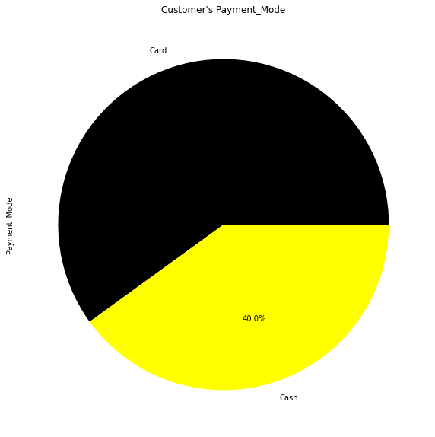
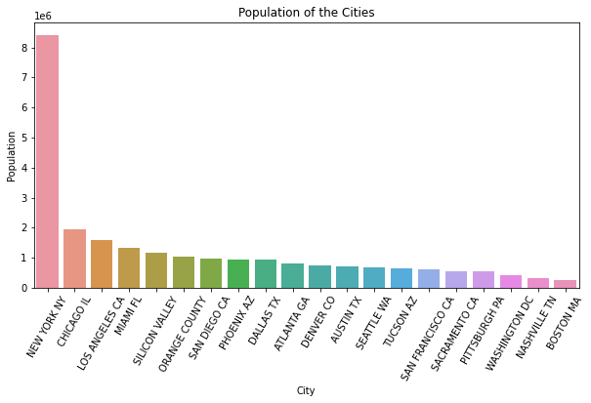
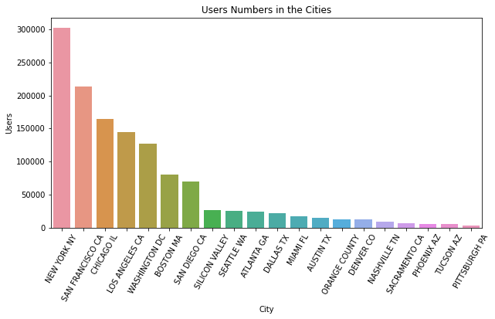
City and Transaction ID Datasets Analysis
We can see the population and the cab user numbers of the cities. Also, according to the pie chart, it is clear that the card is a more preferred payment method.

Slide 19
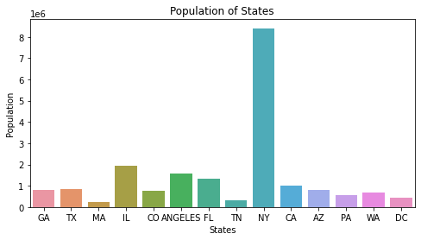
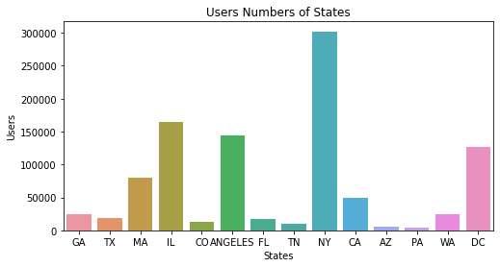
We can also see the population and the cab user numbers of the states.

Slide 20
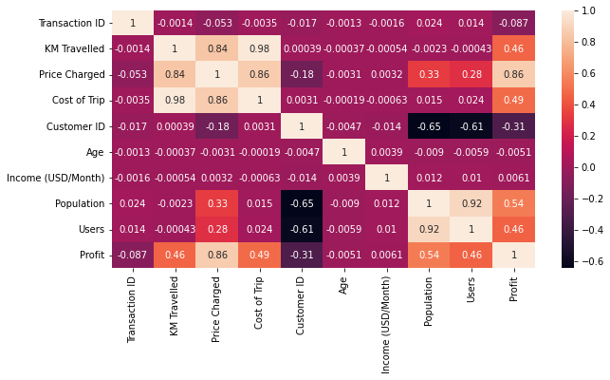
KM Travelled is correlated to Price Charged and Cost of Trip. As KM Travelled increases the Price Charged and Cost of Trip also increase. As the Price Charged increases so does the Profit obviously. Population is slightly correlated with Price charged. Cab drives in the cities with high population cost more and profit also increases. Also users and population is highly correlated. As the city population increases, the user numbers also increase. Lastly, profit and population is somehow correlated.

Slide 21
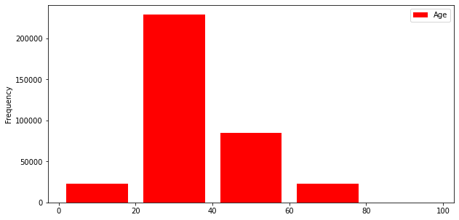
People between the ages of 20 and 40 preferred taxis more.

Slide 22
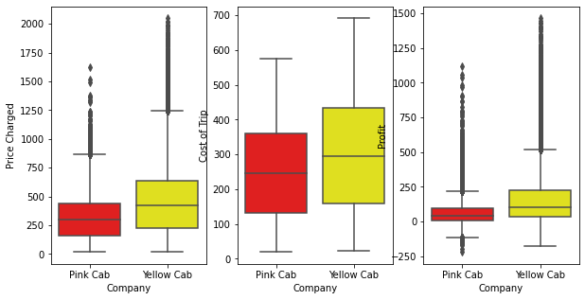
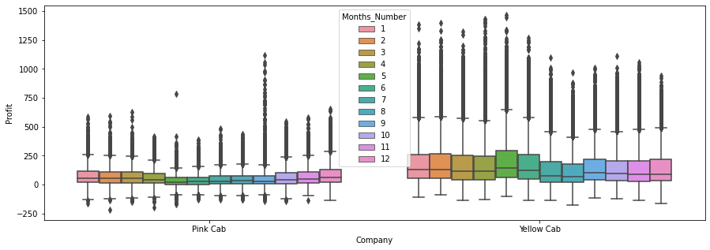
Comparison of pink and yellow cabs
Yellow cabs charge price more, they have slightly higher cost of trip and higher profit in total.
The profits of yellow and pink cabs do not change considerably over the months.

Slide 23
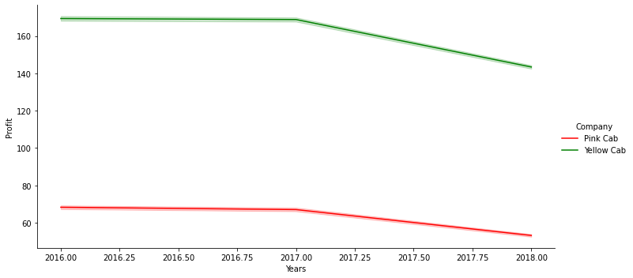
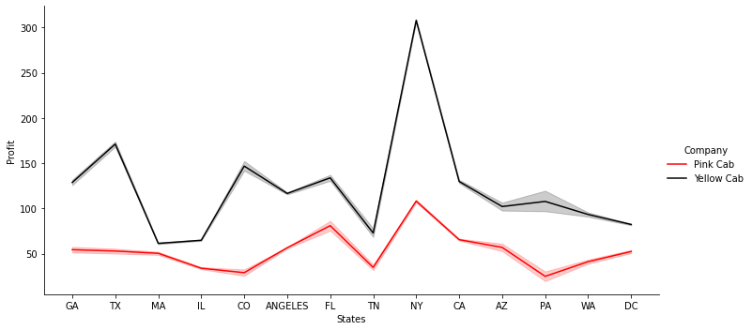
Comparison of pink and yellow cabs
The profits of both cabs drops in 2018.
Both cabs have the highest profit numbers in NYC.

Slide 24
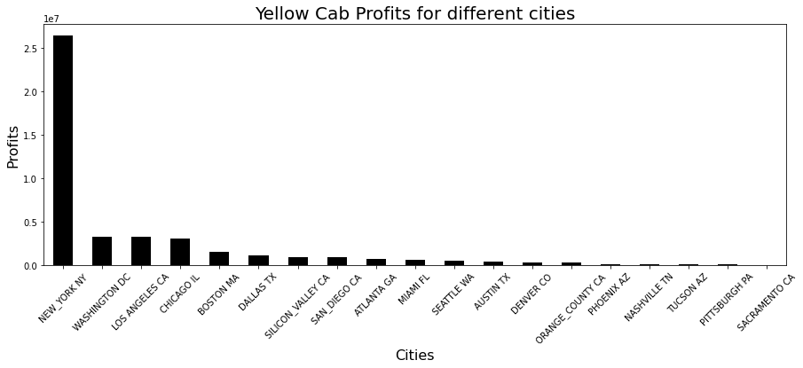
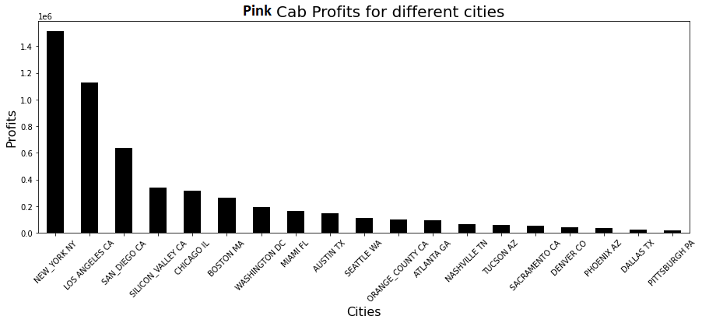
Comparison of pink and yellow cabs
Yellow cab's profits are heavily depend on the profits coming from NYC, while the yellow cab's profits do not depend on one city only.

Slide 25
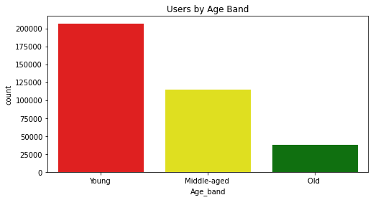
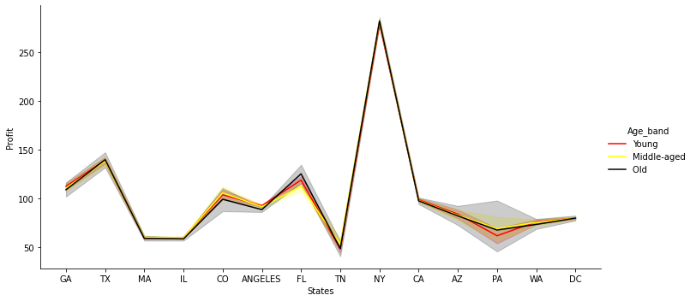
Age Group Analysis
Young age is domianant among the cabs’s customers.

Slide 26
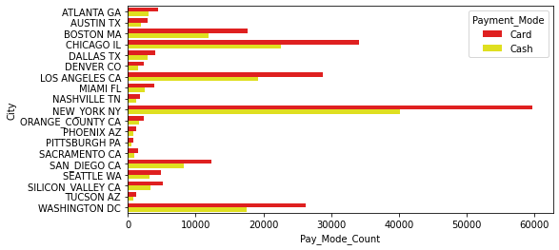
Cash and card use
The card is more preferred among all cities.

Slide 27
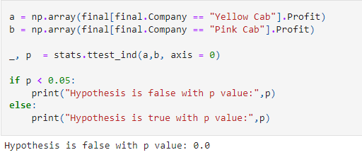
Hypothesis 1: The profit of yellow and pink cabs are almost equal

Slide 28
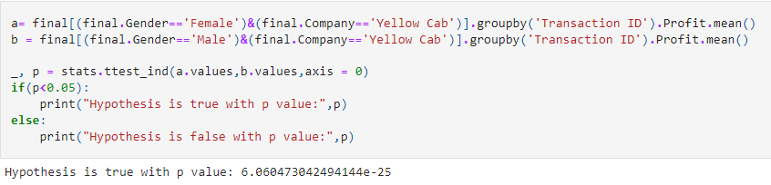
Hypothesis 2: There is difference in profit between genders for yellow cabs

Slide 29
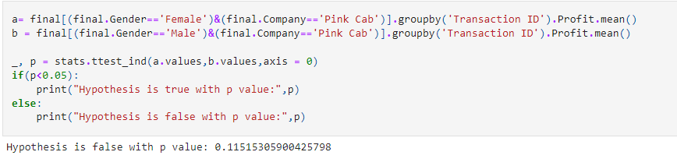
Hypothesis 3: There is difference in profit between genders for pink cabs

Slide 30
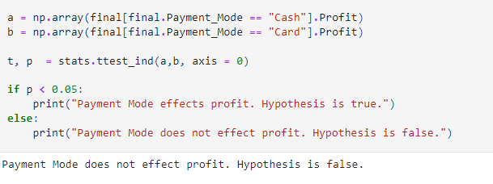
Hypothesis 4: Payment mode effects profits

Slide 31
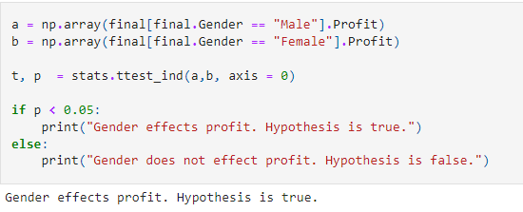
Hypothesis 5: Gender effects profit

Slide 32
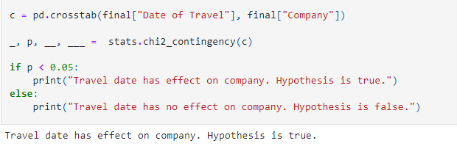
Hypothesis 6: Travel date has effect on preferred company

Slide 33
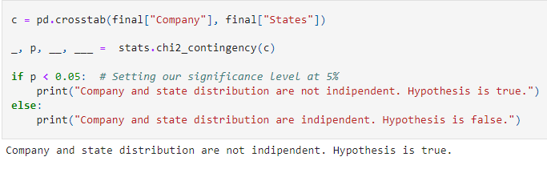
Hypothesis 7: Company and state distribution are not indipendent

Slide 34
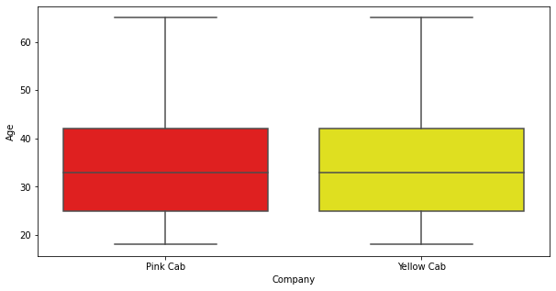
Hypothesis 8: There is an age distribution difference btw yellow and pink cab
According to the graphs given
above the hypothesis is false

Slide 35
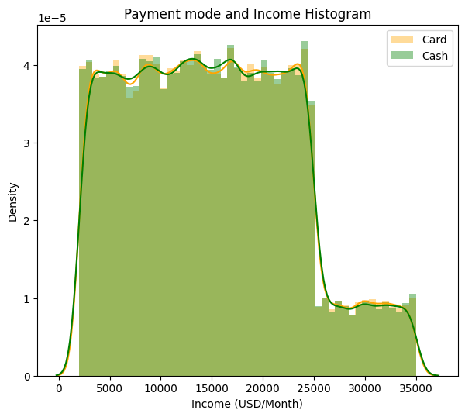
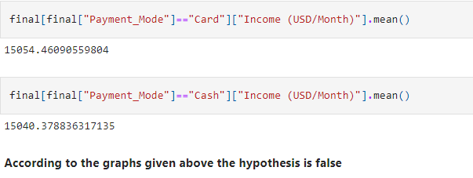
Hypothesis 9: There is an income distribution difference btw card and cash

Slide 36
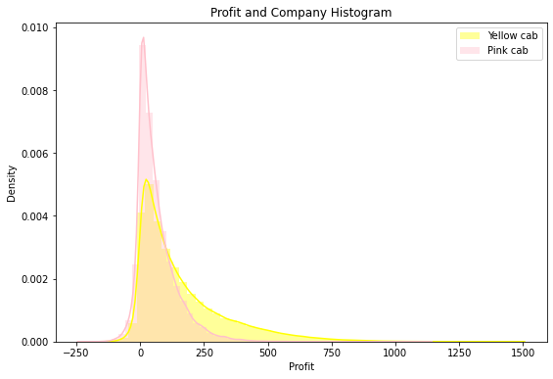
Hypothesis 10: Yellow cabs can profit more

Slide 37
Conclusion
When three years of data were evaluated, it was discovered that the Yellow Cab was more lucrative than the Pink Cab.
In general, the preferred payment method is card.
XYZ corporation should invest in Yellow Cab, according to the full study. Given the losses, XYZ should increase its investment in Yellow Cab in New York.

Slide 38
Thank You

